Slide 1
Testing Planet Hollywood’s Website Usability
Alexis Oales, Juan Uscanga, Patriz Rivera, Christopher Verkaik
ENG 407B

Slide 2
Topics of Discussion
About Planet Hollywood
Las Vegas’s Changing Visitor Demographic (Audience)
Usability Test
Findings
Recommendations

Slide 3
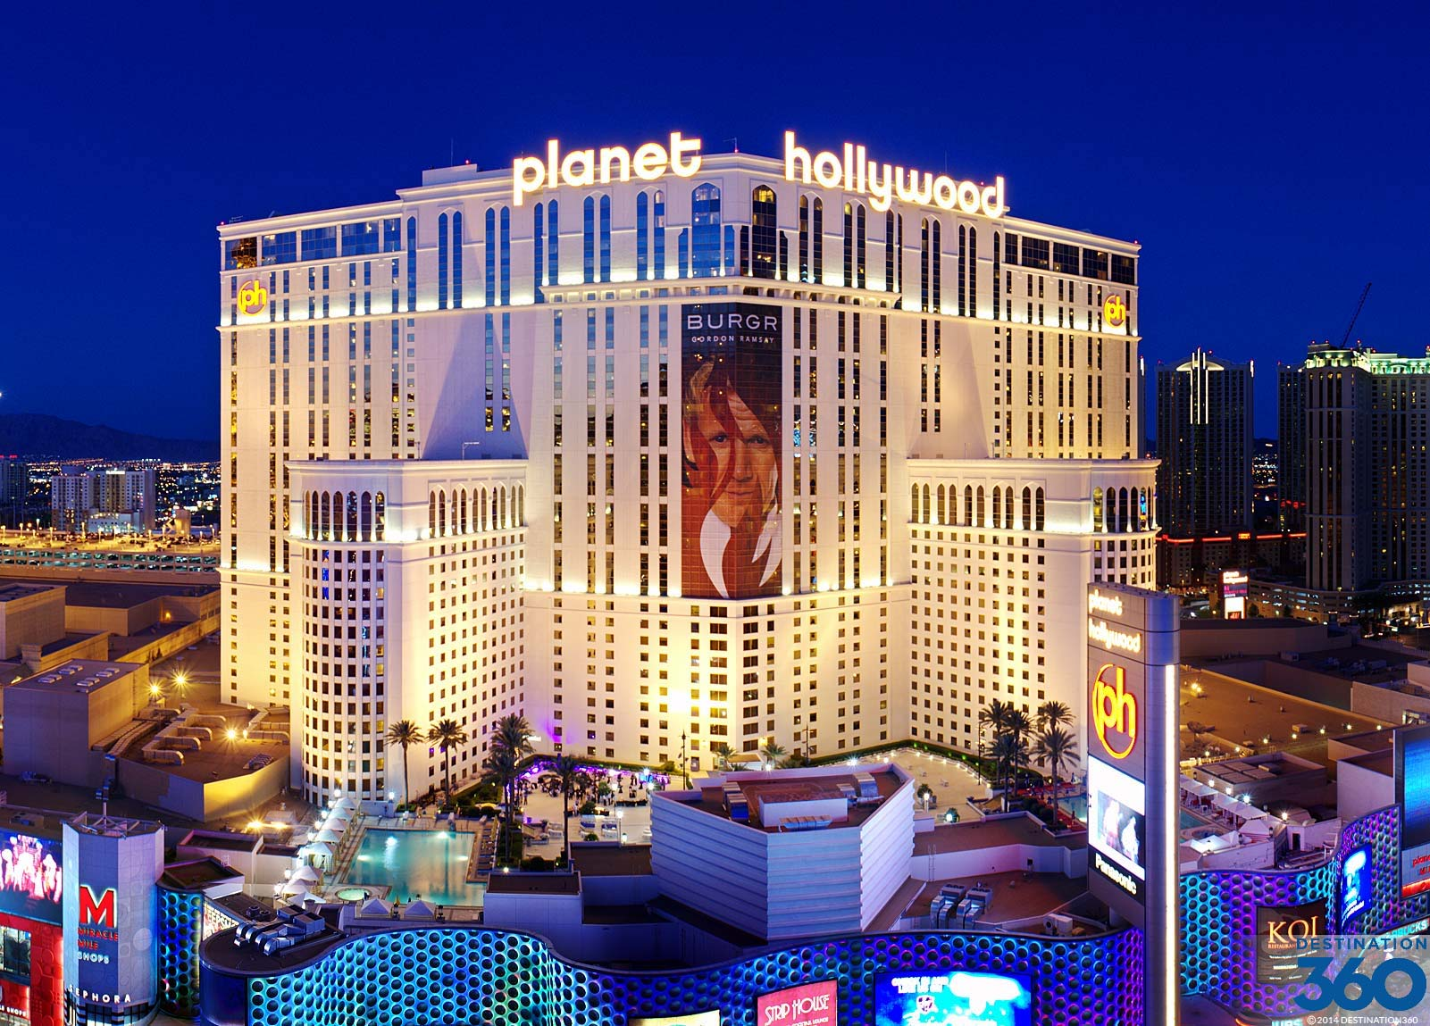
About Planet Hollywood
Located on the Las Vegas Strip
Originally the site of the Aladdin Resort; renovated and reopened as Planet Hollywood in 2007
Currently owned by Caesars Entertainment
Source: http://www.destination360.com/north-america/us/nevada/las-vegas/planet-hollywood

Slide 4
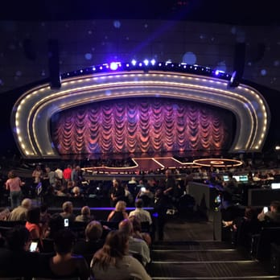
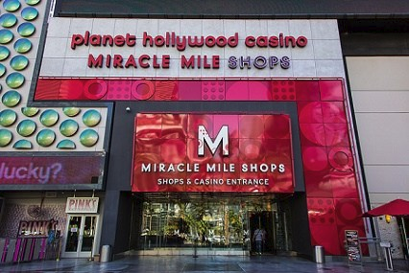
About Planet Hollywood
Miracle Mile Shops
AXIS Theater
Source: https://gamboool.com/
Source: https://www.yelp.com

Slide 5

About Planet Hollywood
Targeting Younger Visitors
AXIS Theater hosts musical acts that appeal to younger visitors
Foursquare lists Planet Hollywood #7 of the 13 best places for college students in Las Vegas
Source: https://twitter.com/britneyspears

Slide 6
Las Vegas’s Changing Visitor Demographic
Las Vegas Visitors Breakdown by Age Group
 | 2013 | 2014 | 2015 | 2016
21 to 29 | 15% | 17% | 12% | 19%
30 to 39 | 27% | 27% | 22% | 25%
40 to 49 | 19% | 20% | 23% | 20%
50 to 59 | 15% | 14% | 15% | 16%
60 to 64 | 9% | 8% | 9% | 8%
64 or older | 15% | 15% | 19% | 12%
Source: Las Vegas Convention and Visitors Authority

Slide 7
Las Vegas’s Changing Visitor Demographic
Younger Visitors are Gambling Less
2008 LVCVA study: 6% of visitors get 21 to 24 come to Las Vegas with the primary purpose of gambling.

Slide 8
Las Vegas’s Changing Visitor Demographic
Millennials and Generation Z
Millennials = born 1977 to 1995
Generation Z = born 1996 to later
Generation Z are digital natives. They can’t remember a world before the Internet.
Mobile devices are most used to access web content.

Slide 9

Creating Our Survey
Creating our survey was based on:
Planet Hollywood’s goals
Planet Hollywood’s target demographic
Changing demographic of Las Vegas visitors
Source: PC Mag - https://www.pcmag.com/article2/0,2817,2498697,00.asp

Slide 10

Participant Demographic
Wanted to ensure that:
Participants were within Planet Hollywood’s target demographic
testing and recommendations held the greatest relevance
Source: Purdue University - https://purduecco.wordpress.com/2016/11/15/diversity-statements-for-academic-job-applications/

Slide 11

Participants and Technology
Two pieces of data that greatly affect the validity of our research:
Computer skills
Preferred internet device
Source: Tech Expert - http://www.techiexpert.com/technology-impacts-work-culture/

Slide 12
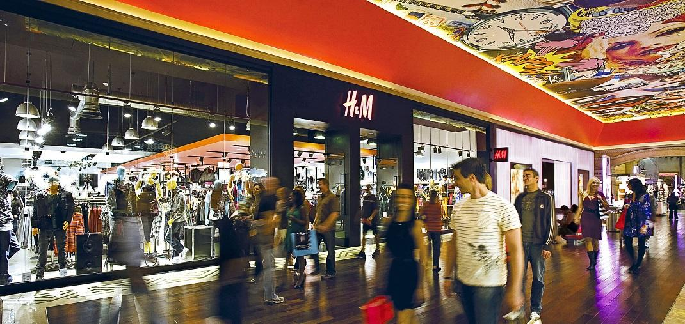
Participants and Planet Hollywood
How users interact with Planet Hollywood:
Activities they participate in (shows, gambling, etc)
Budget for a night out at Planet Hollywood
Source: Top Ten Tickets -
http://www.toptentickets.com/miracle-mile-shops-best-vegas-shopping-malls/

Slide 13

Testing Website Usability
After conducting research and determining our participant’s demographic,
We tailored our testing to focus on the most common ways users would interact with Planet Hollywood’s website.
Source: The Myelin Project -
http://myelin.org/tag/hunter-james-kelly-research-institute/

Slide 14
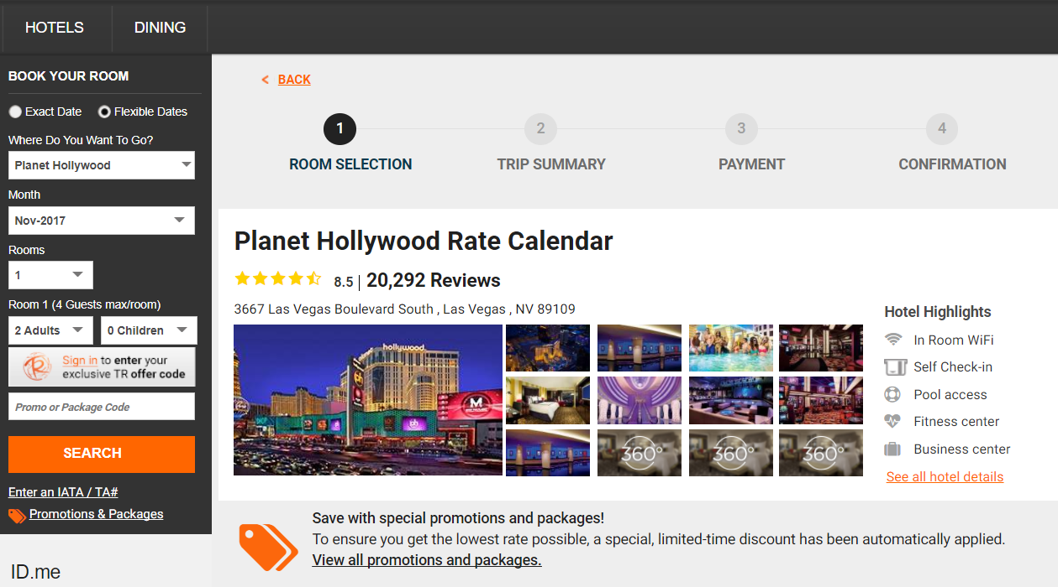
Tasks
Series of 5 tasks:
Book a room
Purchase a ticket
Find shopping info
Find restaurant info
Find a map
Source: Planet Hollywood - Book A Room Webpage, 2017

Slide 15

Tasks Explained
Test ease of use
Test functionality
Determine usefulness and quantity of information
Seek fundamental information (contact information, directions, map, etc)
Source: LinkedIn -
https://www.linkedin.com/pulse/7-point-checklist-sales-appointment-preparation-bryan-higgins

Slide 16

Post-Test Questions
Asking users for feedback on website overall:
Font readability
Website design
Ease of use
Additional recommendations and comments about website
Tech Expert -
http://www.techiexpert.com/data-analytics-score-big-2017/

Slide 17
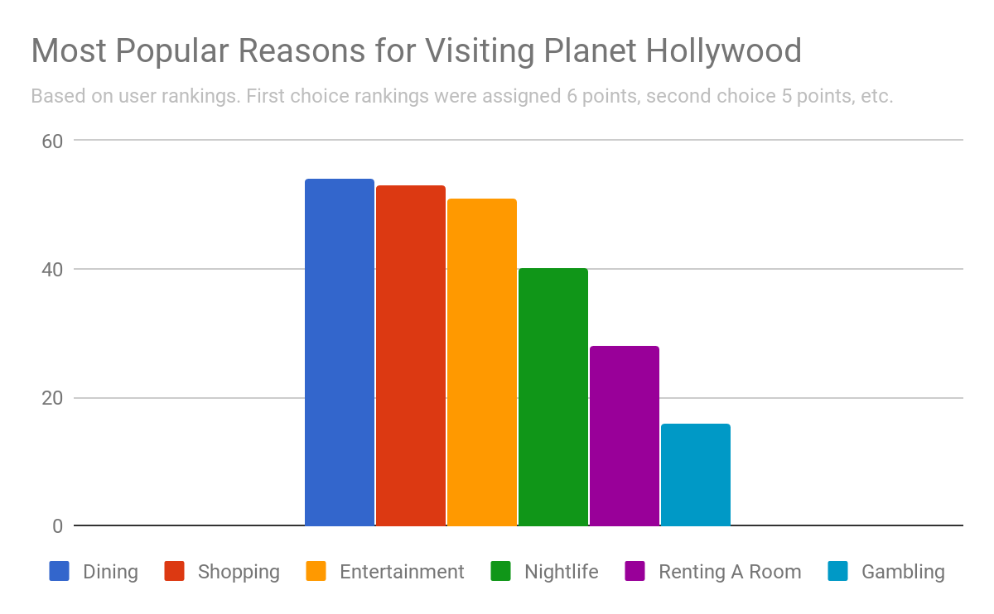
Findings

Slide 18
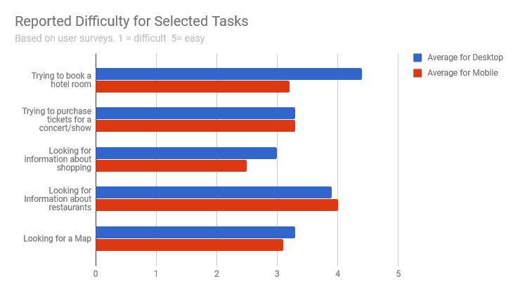
Findings (con’t)

Slide 19
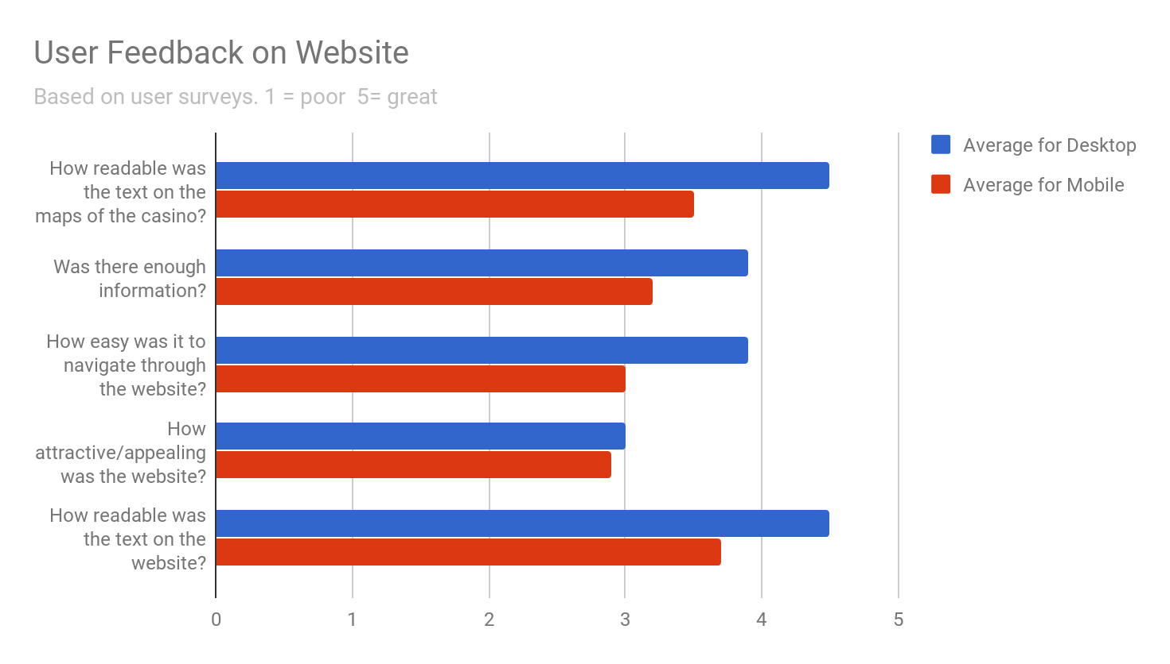
Findings (con’t)

Slide 20

Findings overall...
The areas that seem to need the most improvement are:
The ease of looking up information
about a store/shopping center
as well as other amenities the hotel has to offer ( i.e. information about restaurants )
Making it easier to
Purchase tickets to a show
Book a room
Locate/use the map
Followed by the overall attractiveness and appeal/theme of the website

Slide 21
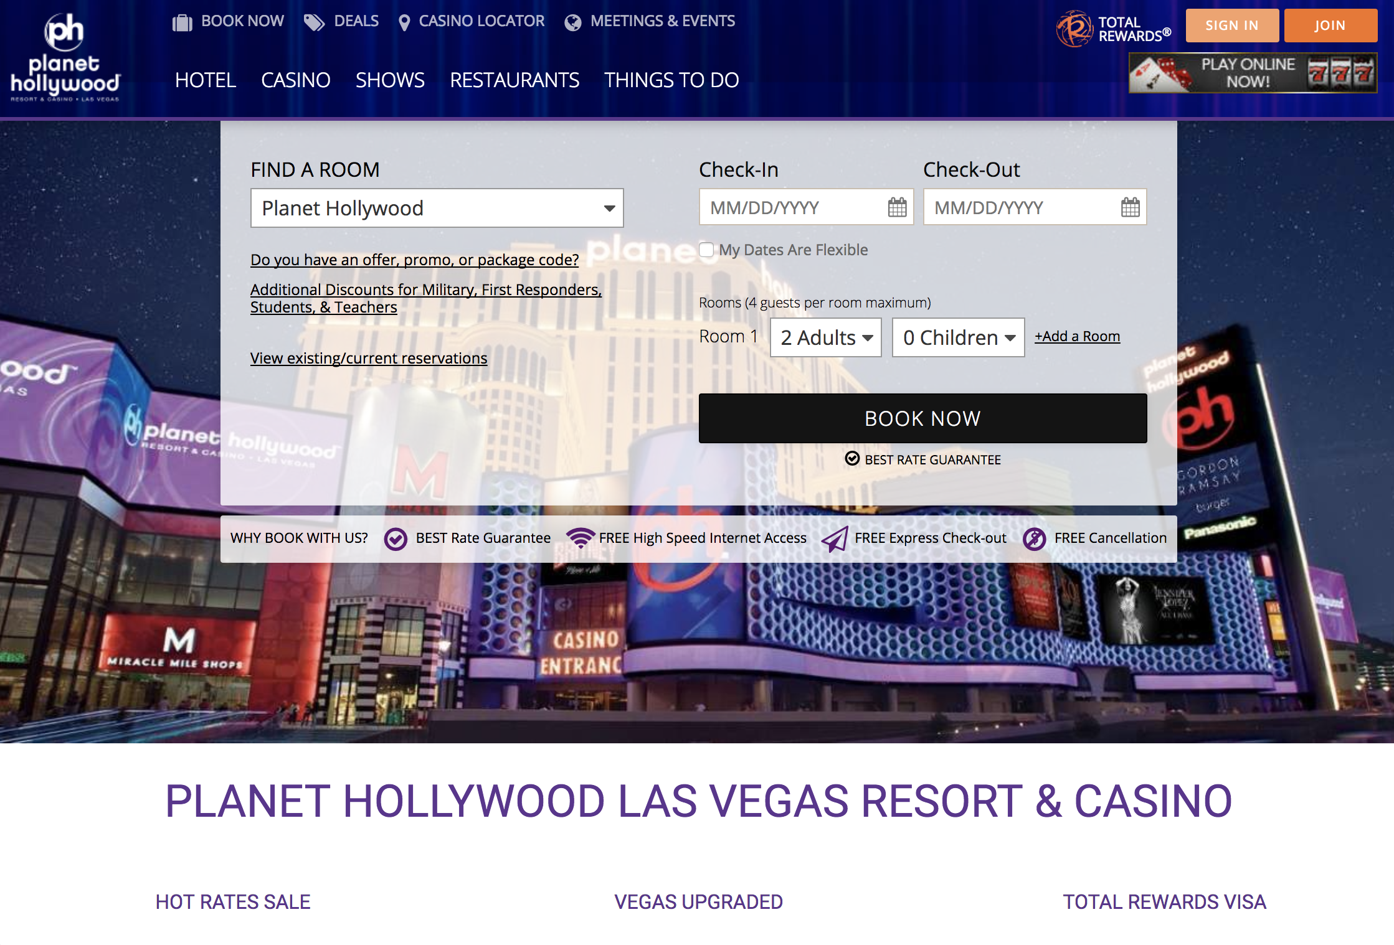
Recommendations
Improve Website Design
Website design does not hold up compared to other casino’s websites
Home page and other web pages are too cluttered
Redesign “Book A Room” and “Purchase A Ticket” webpages
Integrated into the website to reduce redirections
Navigating through multiple links slows down process
Themes are not consistent throughout website
Source: Planet Hollywood - Homepage, 2017

Slide 22
Conclusion
Today we covered the results of our usability project.
We started off by informing you all about some of the background information on Planet Hollywood and their visitor demographics.
We also provided some of our recommendations, accordingly, to improve the
website, which were achieved through our usability testing and its results.

Slide 23
Questions or Concerns?

